Slide 1
EXP 7
To understand SAST process and learn to integrate Jenkins SAST to SonarQube/Gitlab

Slide 2
STATIC APPLICATION SECURITY TESTING (SAST)
Static application security testing (SAST), or static analysis, is a testing methodology that analyzes source code to find security vulnerabilities that make your organization's applications susceptible to attack.
SAST scans an application before the code is compiled. It's also known as white box testing.
SAST takes place very early in the software development life cycle (SDLC) as it does not require a working application and can take place without code being executed. It helps developers identify vulnerabilities in the initial stages of development and quickly resolve issues without breaking builds or passing on vulnerabilities to the final release of the application.

Slide 3
SAST
These tools can scan millions of lines of code in a matter of minutes. SAST tools automatically identify critical vulnerabilities—such as buffer overflows, SQL injection, cross-site scripting, and others—with high confidence.
Thus, integrating static analysis into the SDLC can yield dramatic results in the overall quality of the code developed.

Slide 4
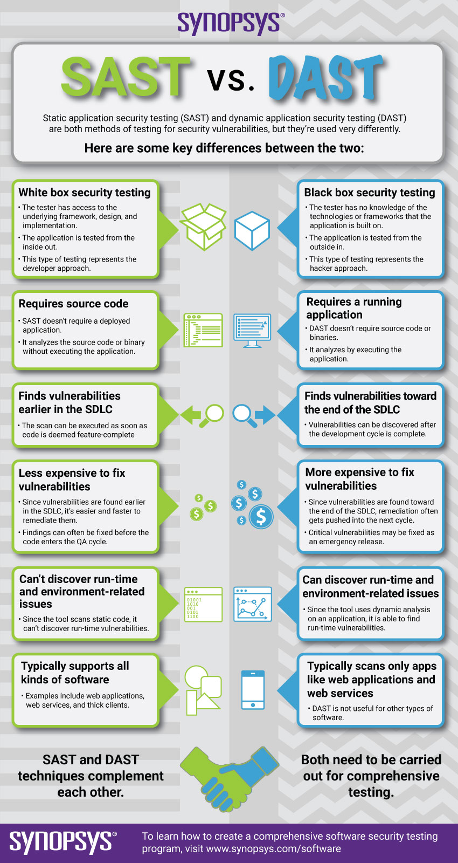

Slide 5
STEPS:
1) Install and configure a Jenkins and SonarQube CICD environment using Docker
containers.
2) Configure Jenkins with the SonarQube Scanner plugin for automated static code analysis.

Slide 6
1..Install and configure a Jenkins and SonarQube CICD environment using Docker containers.
Installation of Jenkins : Ref :https://www.digitalocean.com/community/tutorials/how-to-install-jenkins-on-ubuntu-22-04
manjusha@apsit:~$ wget -q -O - https://pkg.jenkins.io/debian-stable/jenkins.io.key |sudo gpg --dearmor -o /usr/share/keyrings/jenkins.gpg
manjusha@apsit:~$ sudo sh -c 'echo deb [signed-by=/usr/share/keyrings/jenkins.gpg] http://pkg.jenkins.io/debian-stable binary/ > /etc/apt/sources.list.d/jenkins.list’
After ufw allow8080
Sudo ufw allow openSSH
Sudo ufw enable
Follow all the steps for installation …..
Once Jenkin is ready next step is to setup SonarQube Setup

Slide 7
SONARQUBE
SonarQube is an open-source platform developed by SonarSource for continuous inspection of code quality to perform automatic reviews with static analysis of code to detect bugs, code smells on 29 programming languages.
What is SonarQube and Jenkins?
This plugin lets you centralize the configuration of SonarQube server connection details in Jenkins global configuration.
Then you can trigger SonarQube analysis from Jenkins using standard Jenkins Build Steps or Jenkins Pipeline DSL to trigger analysis with: SonarScanner.

Slide 8
EXP 8 :CREATE A JENKINS CICD PIPELINE WITH SONARQUBE / GITLAB INTEGRATION TO PERFORM A STATIC ANALYSIS OF THE CODE TO DETECT BUGS, CODE SMELLS, AND SECURITY VULNERABILITIES ON A SAMPLE JAVA APPLICATION.
Install and configure a Jenkins and SonarQube CICD environment using Docker containers.
Configure Jenkins with the SonarQube Scanner plugin for automated static code analysis.
Create and set up a Jenkins build pipeline using a Jenkinsfile stored within a GitHub repo.
Use the SonarQube web application to examine and review the generated static analysis report.
Use the Blue Ocean Plugin to review Pipeline Steps.

